Slide 1
Finding Safest Neighborhood for Settlement

Slide 2
Project Prepared by-
Name- Sagar Sen
MCA 3rd Semester
ID- 191001270007

Slide 3
Introduction
Background: Safety is a top concern when moving to a new area. If you don’t feell safe in your own home you’re not going to be able to enjoy living there.
Problem: This project aims to select the safest borough in London based on the total crimes, explore the neighbourhood of that borough to find the 10 most common venues in each neighbourhood and finally cluster the neighbourhood using K-Means clustering.
Interest: Expats who are considering to relocate to London will be interested to identify the safest borugh in London and explore its neighborhood and common venues around each neighborhood.

Slide 4
Data Acquisition and Cleaning
Data Acquisition: The data acquired for this project is a combination of data from there sources:
1. The first data source of the project uses a London crime data that shows the crime per borough in London
2. The second source of data is scraped from a Wikipedia page that contains the list of London boruoughs. This page contains additional information about the borughs.
3. The third source is the list of Neighbourhoods in the Royal Borough of Kingstone upon Thames as found on the Wikipedia Page.

Slide 5
Methodology
Data Cleaning: The data cleaning process for each of the three sources of data are done separately
From the London crime data, the crimes during the most recent year (2016) are only selected. The major categories of crimes are pivoted to get the total cremes pre the borough for each major category
The second data is scrapped from a Wiki page using Beautiful Soup library in python, so that we can see it in tabular form
The two datasets are merged on the Borough names to form a new dataset. The purpose of this is to visualize crime rates in each borough and identify the borough with the least crimes recorded during the year 2016
After visualizing the crime in each borough we can find the borough with the lowest crime rate. The third data set is created with the names of the neighborhood and the name of the borough with the latitude and longitude obtained using Google maps API Geocoding
The new dataset is used to generate the 10 most common venues for each neighborhood using the Foursquare API. Finally K-mean clustering to cluster similar neighborhood together

Slide 6
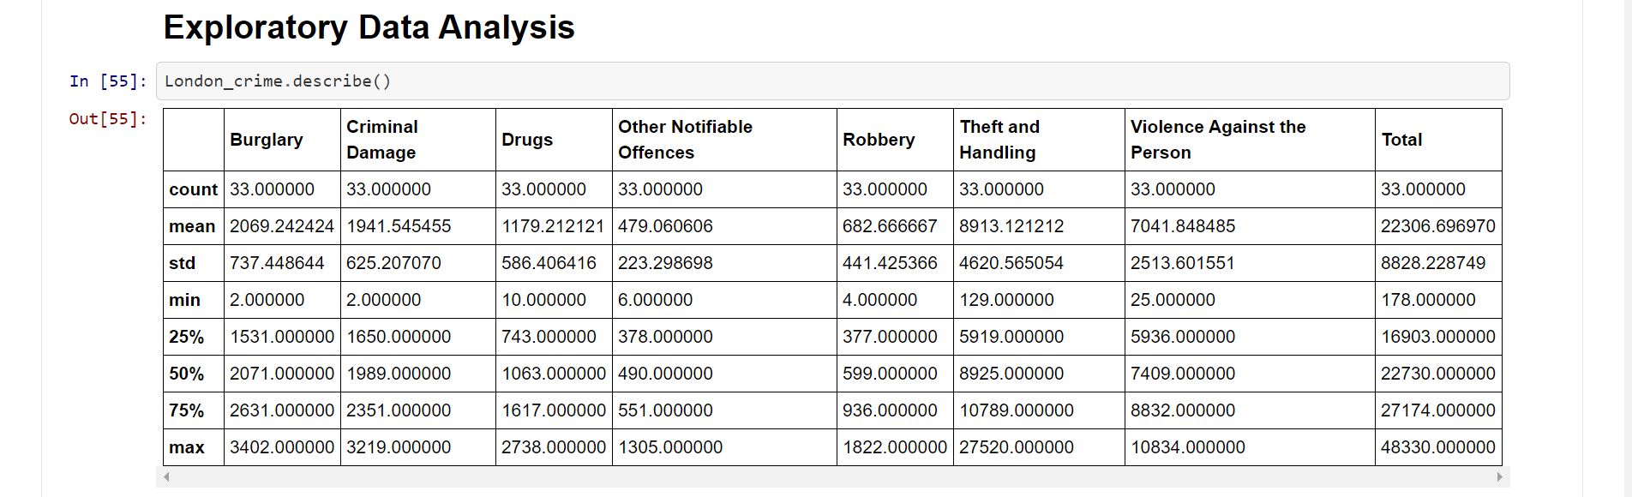
Methodology
Exploratory Data Analysis
The count for each of the major categories of crimesreturns the value 33 which is the number of London boroughs’Theft and Handling’ is the highest reported crime during the year 2016 followed by ‘Violence against the person’ ‘Criminal damage’. The lost recorded crimes are ‘Drugs’, ‘Robbery’ and other ‘Notifiable offenses’

Slide 7
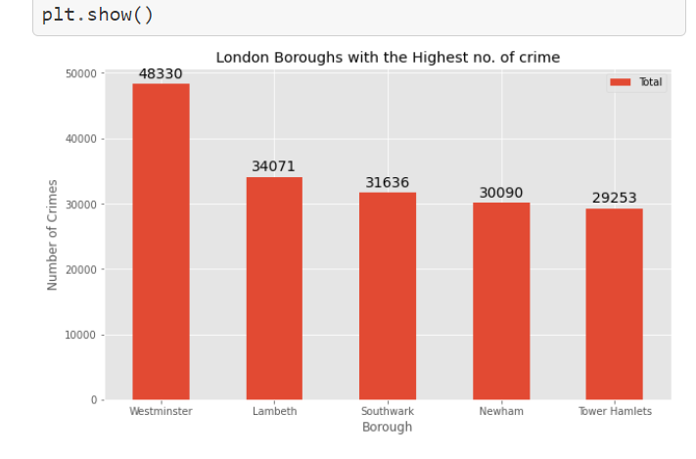
Boroughs with the highest crime rates
Comparing five boroughs with the highest crime rate during the year 2016 is evident that Westminster has the highest crimes recorded followed by Lambeth.Soughwark,Newha, and Town Hamlets. Westminster has a significantly higher crime rate than the other 4 boroughs.

Slide 8
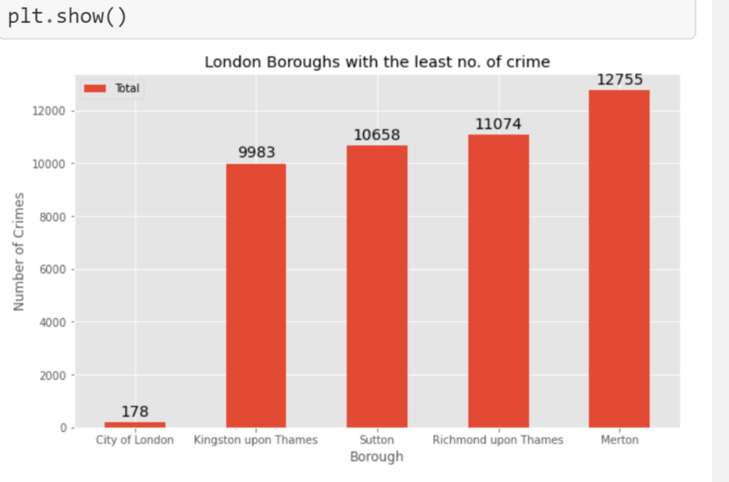
Boroughs with the lowest crime rates
City of London has significant lower crime rate because it is the 33rd principal division of Greater London but it is not a London Borough. It has an area of 1.12 square mile and population of 7000 as of 2013 which suggests that it is a small area
We will consider the next borough with the lowest crime rate as the safest borough in London which is Kingston upon Thames

Slide 9
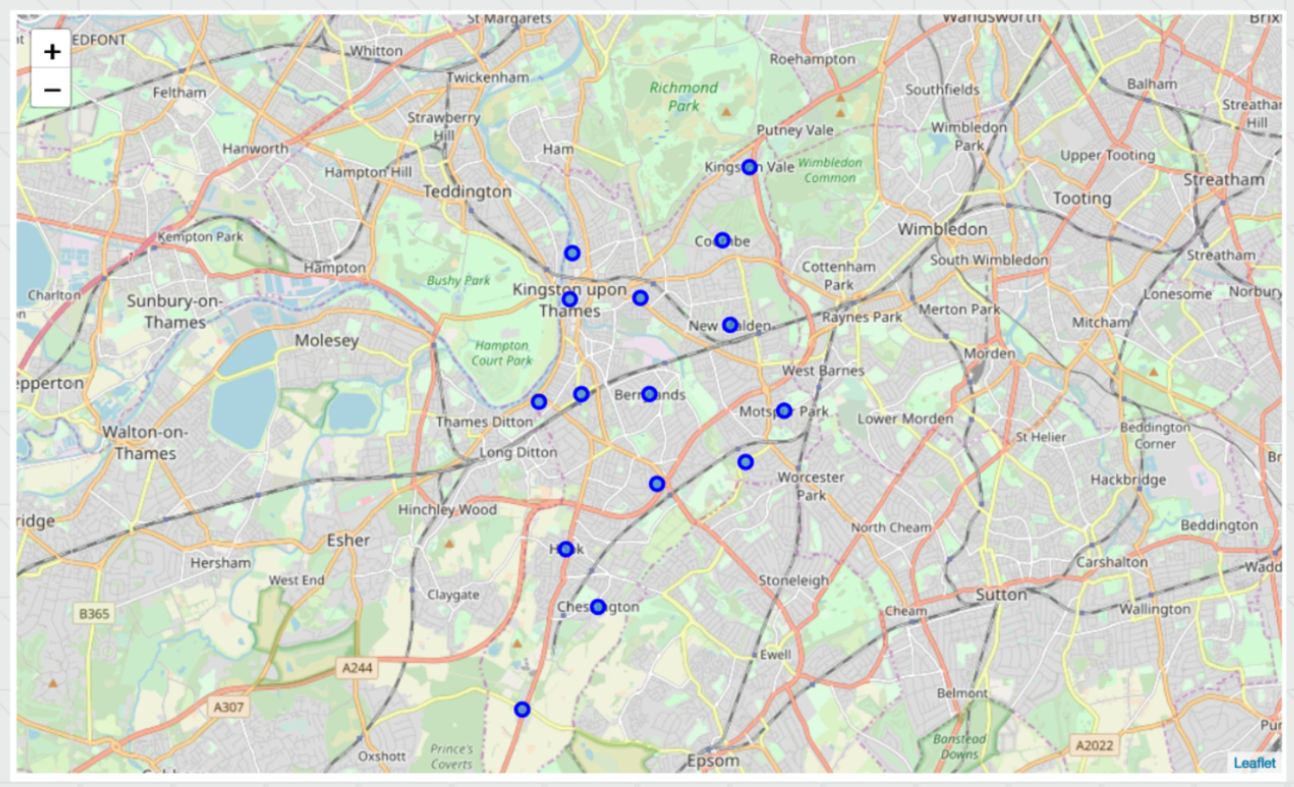
Neighborhood in Kingston upon Thames

Slide 10
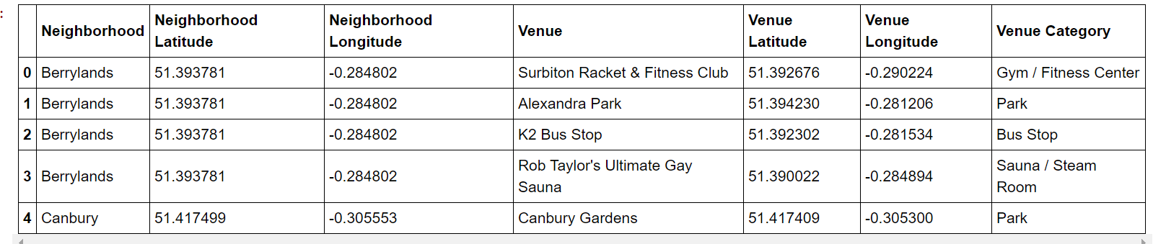
Modelling
Using the final dataset containing the neighborhood in Kingston upon Thames along with the latitude and longitude we can find all the venues within a 500meter radius of each neighborhood by connecting to the Foursquare API
One hot encoding is done on the venues data. The venues data is then grouped by the Neighborhood and the mean of the venues are calculated finally the 10 common venues are calculated for each of the neighborhood
To help people find similar neighborhood in the safest borough we will cluster similar neighborhood K-Means clustering which is a form of unsupervised maching learning algorithm that clusters data based on predefined cluster size.
We will use a cluster size of 5 for the project that will cluster the 15 neighborhood into 5 cluster. The reason to conduct a K-Means clustering is to cluster neighborhood whith similar venue together so that people can shortlist the area of their interest bases on the venues around each neighborhood.

Slide 11
Result
After running the K-Means clustering we can access each cluster created to see which neighborhood were assigned to each of the 5 clusters. Visualization the clustered neighborhood on the map using Folium library.
Each cluster is color for the ease of presentation we can see that majority of the neighborhood falls in the red cluster which is the first cluster. 3 neighborhood have their own cluster(BLUE,PURPLE,YELLOW) and are clusters two three and five. The green luster consists of two neighborhoods which is in 4th cluster.

Slide 12
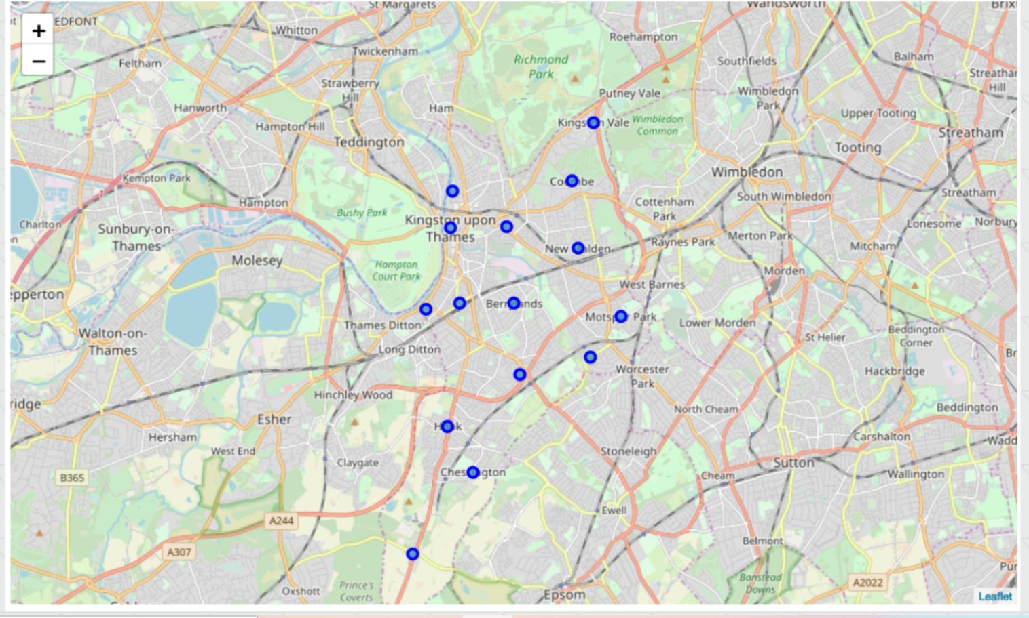
Result

Slide 13
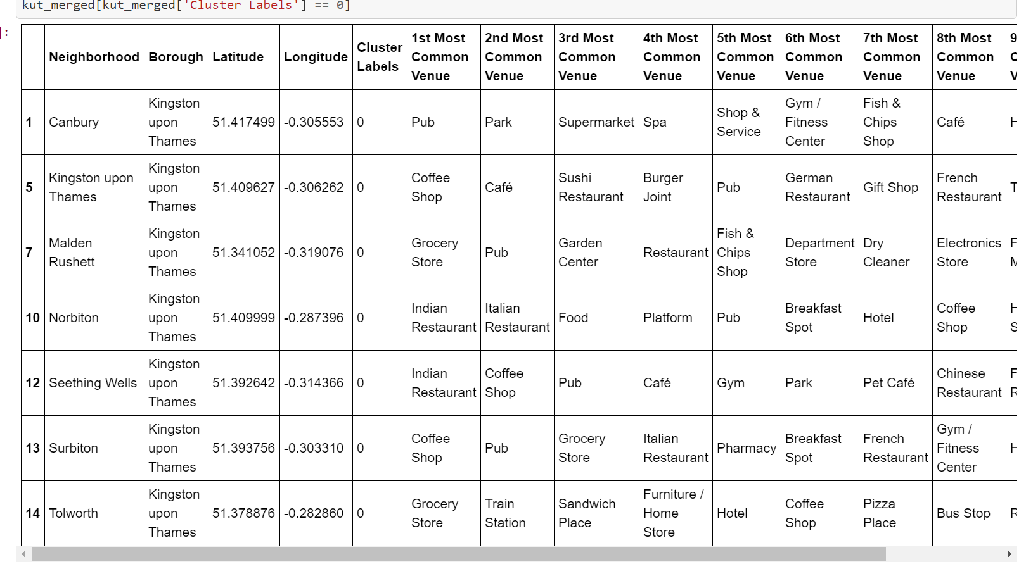
Cluster 1- looking into the neighborhood in first cluster
The cluster one is the biggest cluster with 9 of the 15 neighborhoods in the borough Kingstone upon Thames. Upon closely examining these neighborhoods we can see that the most common venues in these neighborhood are Restaurants,Pubs,Café,Supermarket and store.

Slide 14
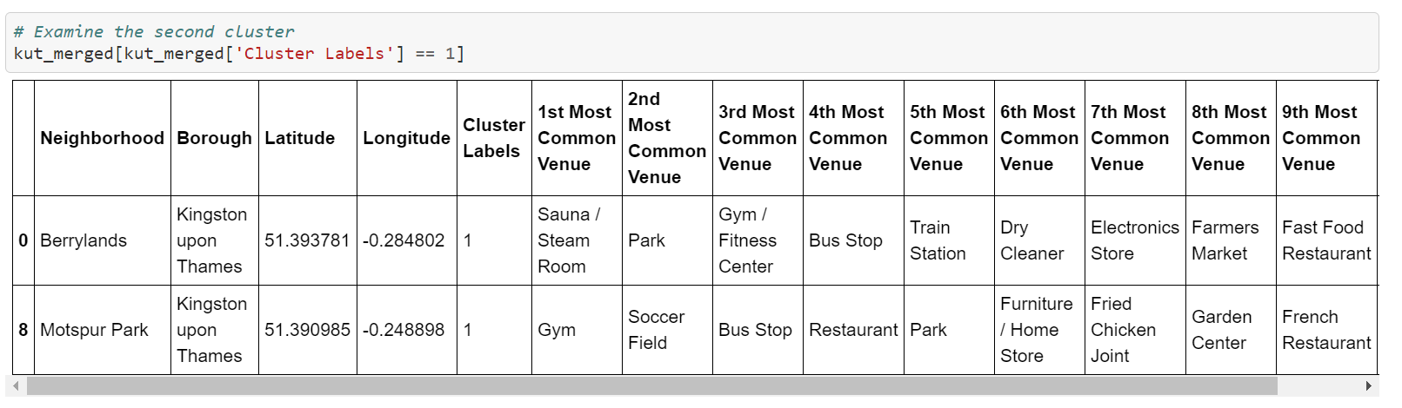
Cluster 2- looking into the neighborhoods in second cluster
Second cluster has one neighborhood which consists of Venues such as Resturant, Golf courses, and wine shop

Slide 15
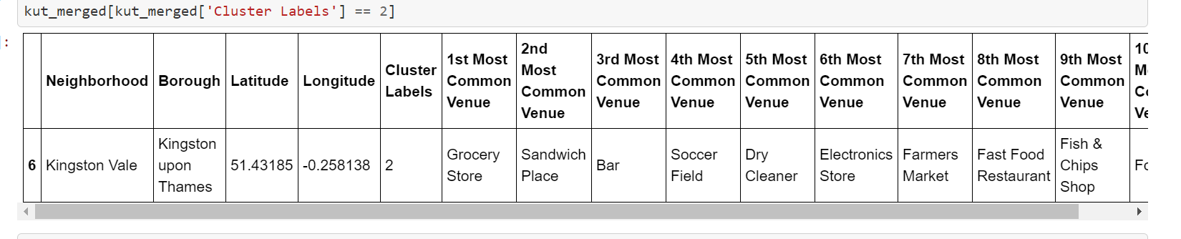
Cluster 3- Looking into the neighborhood in third cluster
The third cluster has one neighborhood which consists of Venues such as Train station, Restaurant, Furniture shops.

Slide 16
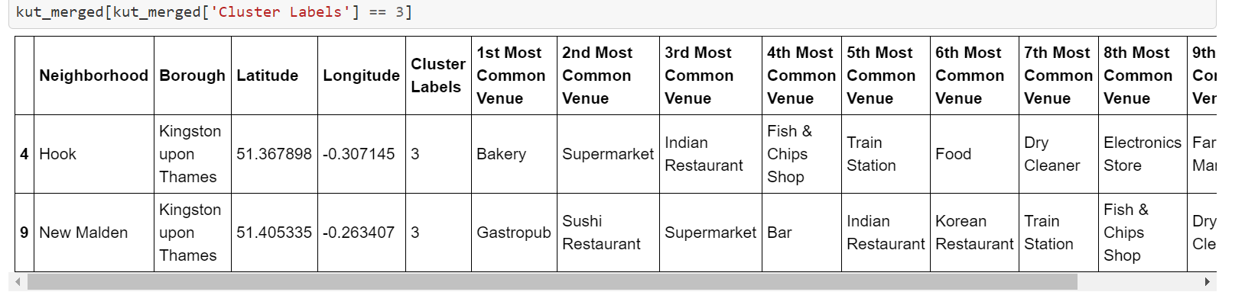
Cluster 4- Looking into the neighborhood in the fourth cluster
The fourth cluster has two neighborhoods in it, these neighborhoods have common venues such as Park, Gym/Fitness centre, Bus stop, Restaurant, Electronic store and Soccer fields

Slide 17
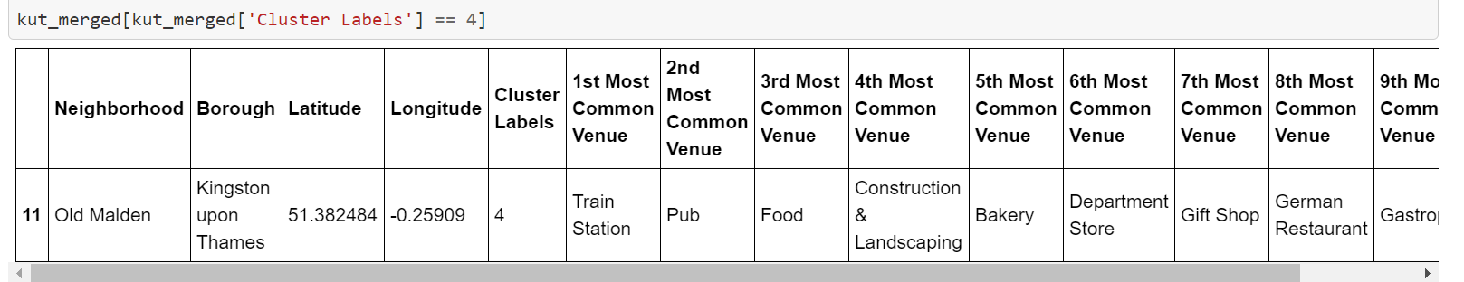
Cluster 5- Looking into neighborhood in fifth cluster
The fifth cluster has one neighborhoods which consists of Venues such as Grocey shops, Bar, Restaurants, Furniture shop and Department stores

Slide 18
Discussion
The aim of the project is to help people who wants to relocate to the safest borough in London, expats can choose the neighborhood to which they want to relocate based on the most common venues in it.
For example if a person is looking for a neighborhood with good connectivity and public transportation we can see that Cluster 3 and 4 have Train Station and Bus stops as the most common venues
If a person is looking for a neighborhood with stores and restaurants in a close proximity then the neighborhood in the First cluster is available
For a family I feel that the neighborhood in Cluster 4 are more suitable due to the common venues such as Parks, Gyms/Fitness centers, Bus Stops, Restaurants, Electronic stores and Soccer fields which is ideal for a family
The preferences of venues may vary from person to person they can select a neighborhood based on ones priorities.

Slide 19
Conclusion
The project helps a person get a better understanding of the neighborhood with respect to the most common venues in that neighborhood. It is always helpful to make use of technology to stay one step ahead i.e. finding out more about places before moving into a neighborhood
We have just taken Safety as a primary concern to shortlist the safest borough of London. The future to this project includes taking ther factors such as cost of living in the areas into consideration to shortlist the borough such as filtering areas based on predefined budget.

